Slide 1
Summary PowerPoint
Ankita Roychoudhury
Murray Lab

Slide 2
From Murray Meeting
10.12.2020
File: 20201012_murray_mtg_2

Slide 3
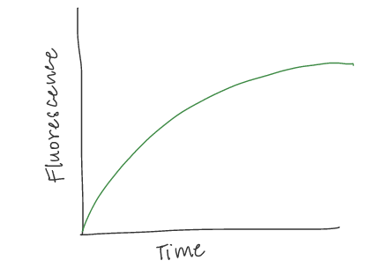
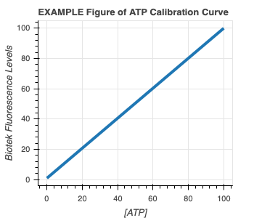
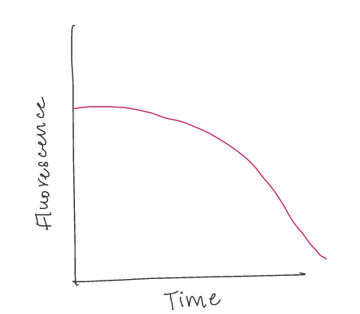
Experimental Plans
1) ATP Calibration Curve 2) Quantify GFP and ATP in bulk TX-TL with DNA
EXAMPLE GFP Curve
EXAMPLE ATP Curve

Slide 4
#2 cont.) Proposed Controls
In all cases, GFP and ATP will be measured
Exp # | deGFP DNA | Energy Buffer | TXTL Extract | Salt | Why?
1 | ✔️ | ✔️ | ✔️ |  | Positive Control
2 |  |  | ✔️ | ✔️ | Negative Control for background fluorescence
3 |  | ✔️ | ✔️ |  | Quantify ATP depletion due to metabolic leak
4 | ✔️ |  | ✔️ | ✔️ | How does the system perform without energy? How quickly does energy run out?
5 | ✔️ | ✔️ |  | ✔️ | How does the system perform with only energy?

Slide 5
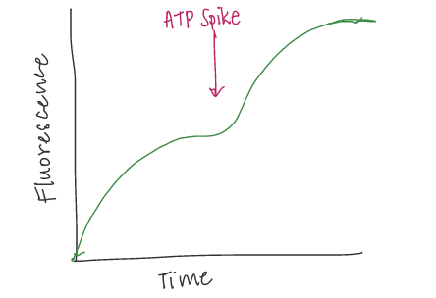
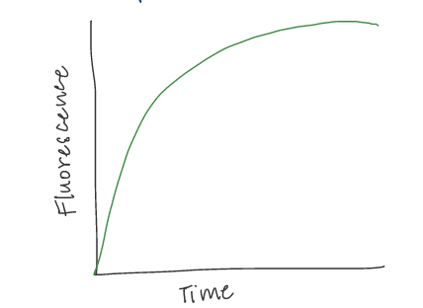
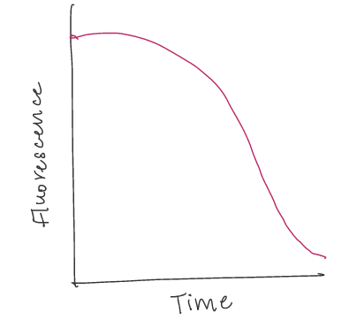
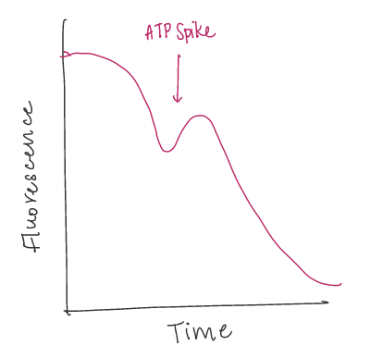
3) Add more ATP at start 4) Add more ATP in middle
PREDICTED GFP Curve
EXAMPLE GFP Curve
PREDICTED GFP Curve
EXAMPLE ATP Curve
PREDICTED ATP Curve
PREDICTED ATP Curve
Hypothesis: Proportionally more protein production with more initial ATP
Hypothesis: Can revive protein production with ATP spike

Slide 6
After that…
5) Greater Initial Concentration and Spike Experiments with 3PGA, Energy Mix, and/or DNA to see if any are the limiting factor
6) Characterize GFP and ATP with TXTL Extract, Buffer, & DNA in vesicles
7) Add ATP Synthase, Proton Pump, and Test!

Slide 7
Experiments 1,2,3

Slide 8
Summary
learn biotek, try to learn echo with Miki.
Pipetting was good, DNA stored in 4C box

Slide 9
Exp 4: ATP Controls (Attempt 1)
Saved as 20201020_exp4_controls

Slide 10
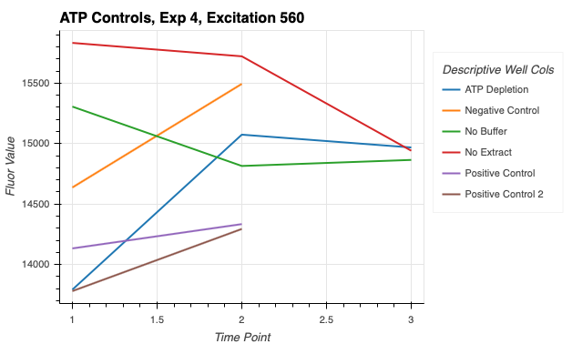
Controls:
2x Positive control – deGFP DNA, buffer, extract
Negative control – extract
ATP depletion – buffer, extract
No buffer – deGFP DNA, extract
No extract – deGFP DNA, buffer
Adapted from ATP_Assay_Fluorescence protocol
Which is wrong!! Needed to use luminescnce
Notes:
ATP depletion does not have DNA, seems to have less ATP in the beginning and then progressively more. Not sure why. Maeks sense that it has the lowest starting point. How come negative control is higher tho?? Most likely because extract has some color.
Negative control with only extract increased in ATP?? What’s going on there.
No buffer, some atp use but then none.
No extract, makes sense that it has the highest starting point, some is used
Positive control uses more in the beginning, gets higher why? More atp is being produced maybe by atp regeneration pathway

Slide 11
Takeaways
Can’t take data too seriously because of incorrect data collection
ATP depletion does not have DNA, seems to have less ATP in the beginning and then progressively more. Not sure why. Maeks sense that it has the lowest starting point. How come negative control is higher tho?? Most likely because extract has some color.
Negative control with only extract increased in ATP?? What’s going on there.
No buffer, some atp use but then none.
No extract, makes sense that it has the highest starting point, some is used
Positive control uses more in the beginning, gets higher why? More atp is being produced maybe by atp regeneration pathway

Slide 12
Exp 5: ATP Assay Calibration
20201019_exp5_atpassaycalibration

Slide 13
Doing both Standard ATP Assay (as described in Cayman Chem protocol)
https://www.caymanchem.com/pdfs/700410.pdf
- 1 uM, 325 nM, 105.6 nM, 34.3 nM, 11.2 nM, 3.6 nM, 1.2 nM, 0 nM
- And my own ATP assay
- got ATP aliquots from Gibson assembly box 4degC
- assumed 10 mM, 10 uL each
- 5, 1, 10^-1, 10^-2, 10^-3, 10^-4 mM
Adapted from ATP_Assay_Fluorescence protocol
Which is wrong!! Needed to use luminescnce

Slide 14
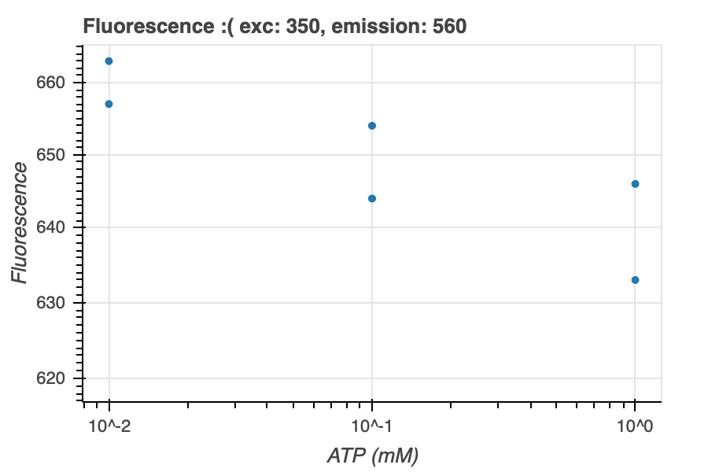
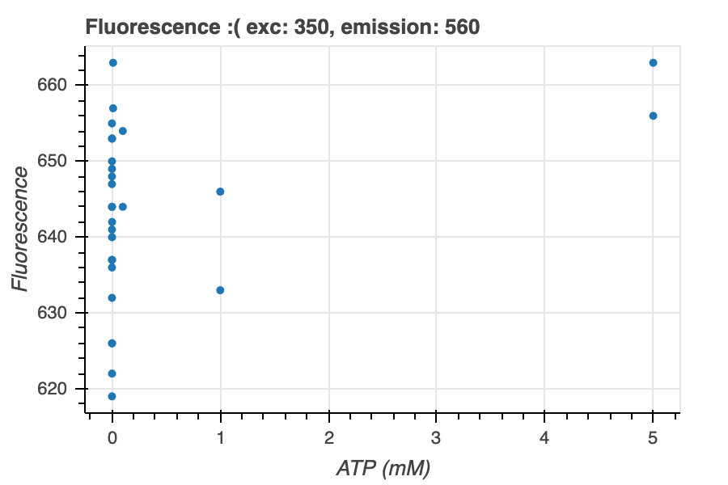
This was wrong because did fluorescence not luminescence

Slide 15
Exp 6: Controls for a longer time + GFP
20201021_exp6_controls_longertime+gfp

Slide 16
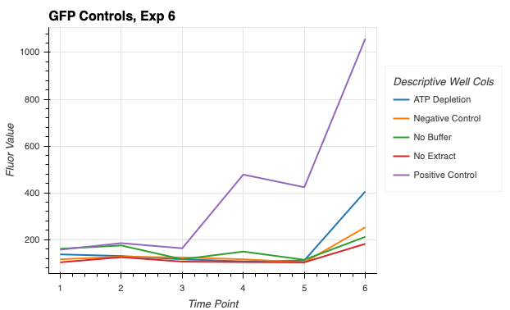
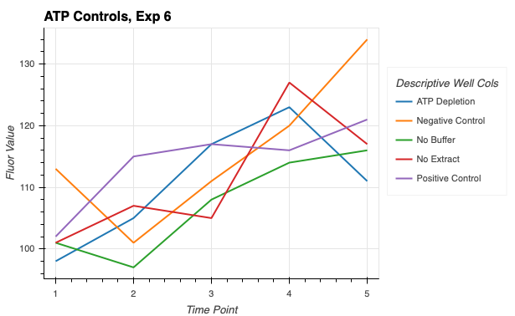
Collected ATP and GFP
Collected 5 time points on 10/21. Collected 1-2 time points on 10/22
Day 2 was almost useless, most of the liquid from E stock wells evaporated
Need to repeat and make sure to keep plate cover overnight
Can consider GFP data, but Atp data took fluor again

Slide 17
Takeaways
Positive control is fastest, makes sense. Next is ATP depletion, which is weird because that one has no DNA so why is it getting higher GFP? Maybe because of extract but the no buffer is lower.
Negative control is next, so no buffer and no extract are effectively similar to negative control. Which is expected. Weird why the atp depletion is a bit higher. WE can verify this with better time series data.

Slide 18
Exp 7: GFP Controls Time Series
20201022_exp7_controls_gfp_timeseries

Slide 19
Controls:
2x Positive control – deGFP DNA, buffer, extract
Negative control – extract
ATP depletion – buffer, extract
No buffer – deGFP DNA, extract
No extract – deGFP DNA, buffer

Slide 20
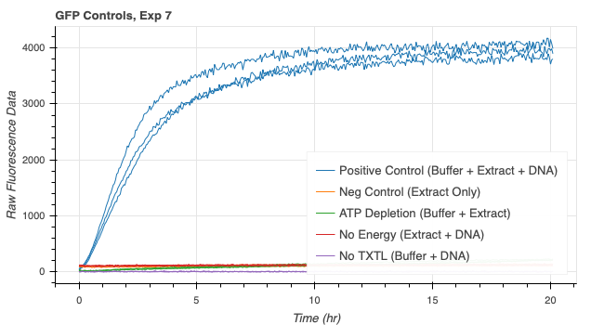
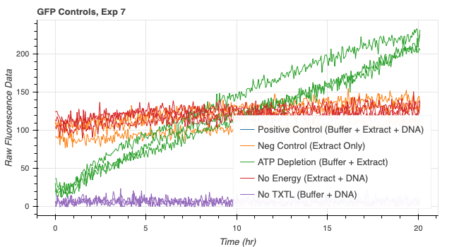
Plotting with Processing functions
Notes:
As expected, positive control is way higher than the rest.
ATP Depletion higher than the rest again!!! Consider WHY!!!
pH based fluorescence change maybe. MK data goes lower for buffer + extract and buffer + extract + DNA (not seen for DNA here maybe because GFP overpowers those differences)

Slide 21
Takeaways
As expected, positive control is way higher than the rest.
ATP Depletion (only buffer) higher than the rest again!!! Consider WHY!!!
Why is it higher than just the extract portion

Slide 22
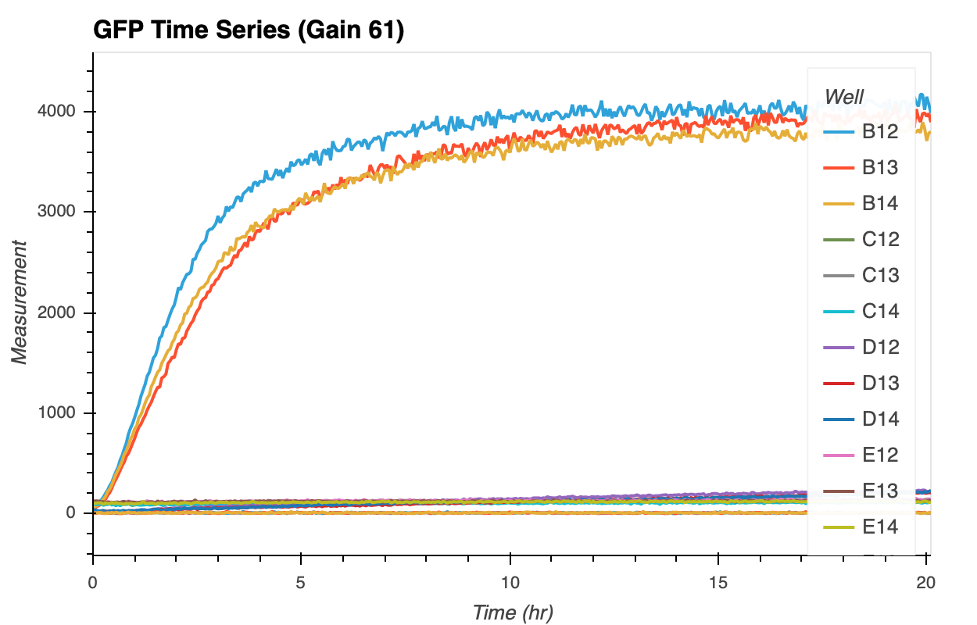
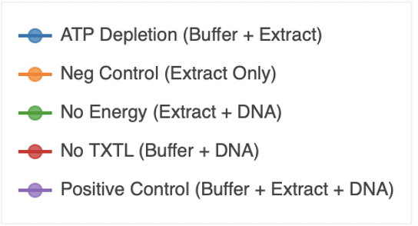

Slide 23
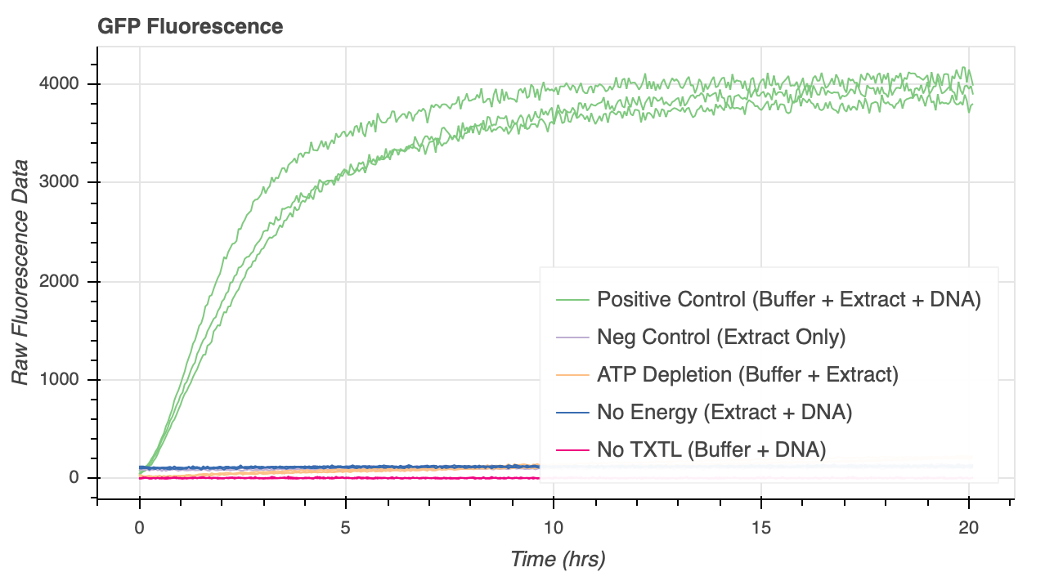
Better plotting

Slide 24
Exp 8: GFP and ATP Long Controls
20201023_exp8_controls_gfp_atp

Slide 25
Controls:
2x Positive control – deGFP DNA, buffer, extract
Negative control – extract
ATP depletion – buffer, extract
No buffer – deGFP DNA, extract
No extract – deGFP DNA, buffer
ATP assay reaction done with luminescence again☹
Didn’t really fix the analysis .ipynb file (serious problems but useless data)

Slide 26
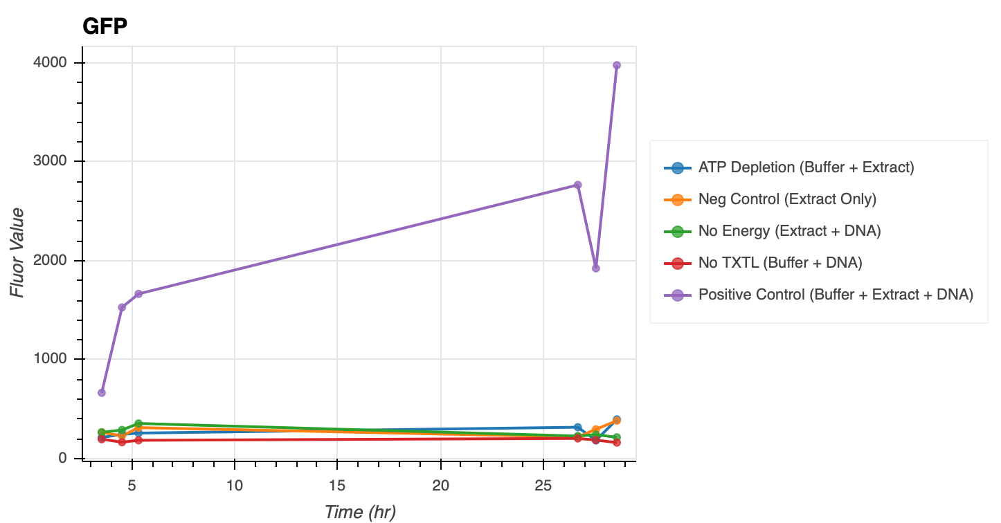
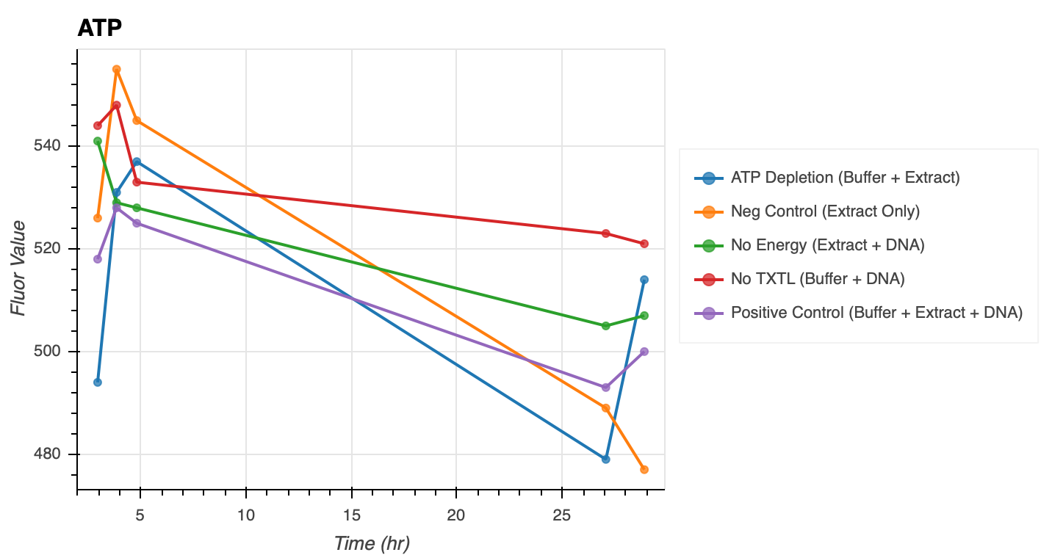
The last data point had bubbles (removed from graphs)
Also used fluorescence, which is wrong☹

Slide 27
Exp 9: ATP Assay Calibration Round 2
Done with luminescence
11/2/2020
20201102_exp9_atpassaycalibration_2

Slide 28
ATP Assay Calibration Concentrations
1 uM
325 nM
105.6 nM
34.3 nM
11.2 nM
3.6 nM
11.2 nM 10 uM 0 nM ALL DIVIDED BY 2
Used ABCDEFG Samples from the https://www.caymanchem.com/pdfs/700410.pdf
Also made my own atp aliquots from atp found in lab (all in mM)
5
1
10^-1
10^-2
10^-3
10^-4

Slide 29
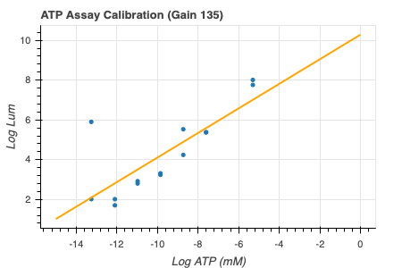
From 12.27.2020 Re-analysis (in mM)
Only used data from standard assay given in Cayman Chem
(slope, intercept) = (0.61778603, 10.2830528)
Use get_atp_concs() from atp_lum_vals.py to get ATP Concentrations (mM) from luminescence values using CaymanChem Assay

Slide 30
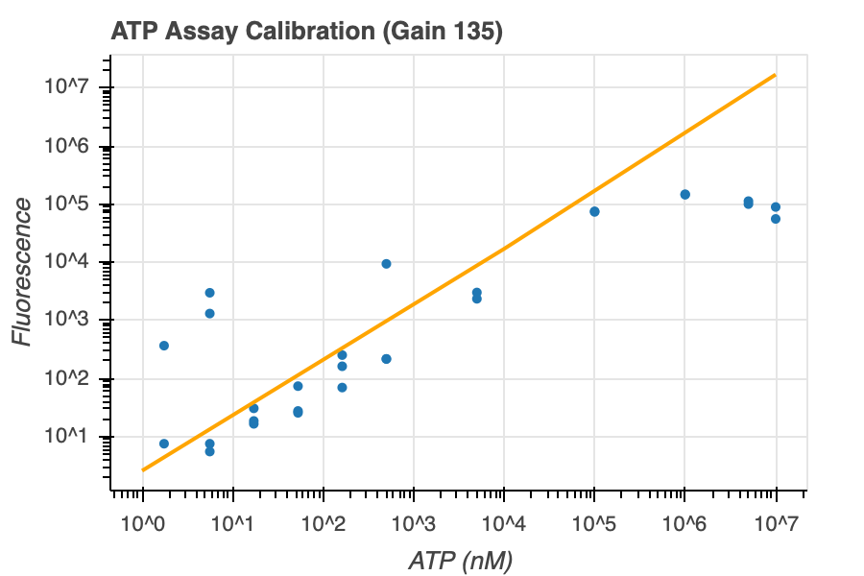
slope=1.2732601723574946,
intercept=-1.6966496369015145
Notes:
This includes my data from ATP stock found in lab and is in nM

Slide 31
Exp 10: ATP Control Round 2
Done with luminescence this time!
20201103_exp10_controls_atp

Slide 32
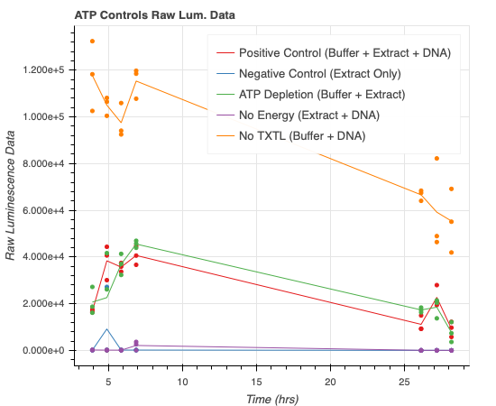
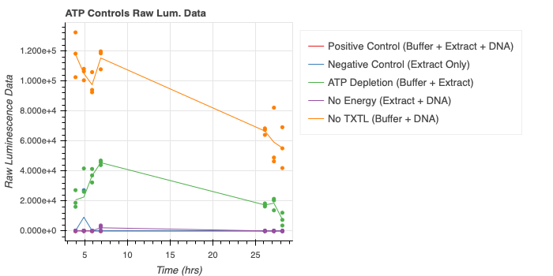
(incorrect, old)

Slide 33
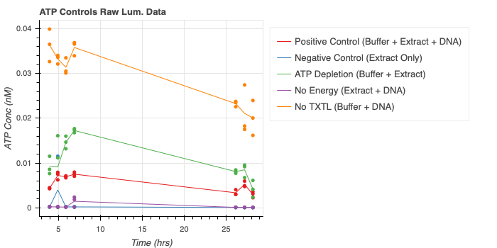
With ATP Conc (incorrect, old)

Slide 34
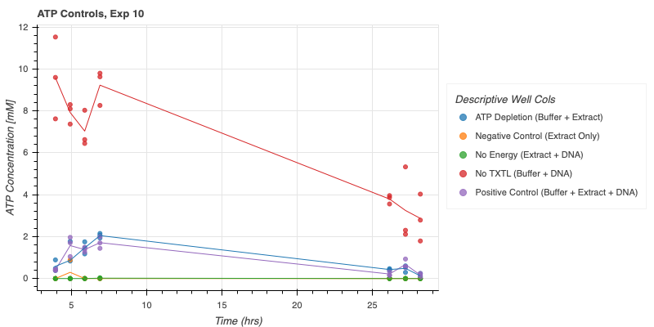
Added 12.31.2020
Notes:
Buffer alone with dna seems to have some pH changing stuff going on, is this systematic? Does this happen continuously?? Or just when the buffer is transferred?? Should see what happens with ATP over time in buffer alone.
Buffer extract and buffer extract dna have the same diference, pretty similar, DNA doesn’t have that much of difference. But DNA is consistently a bit lower, interesting, didn’t Manisha see that with her data too for pH
Negative control and no energy are at the bottom. No ATP in just extract and DNA

Slide 35
Takeaways
Buffer alone with dna seems to have some pH changing stuff going on, is this systematic? Does this happen continuously?? Or just when the buffer is transferred?? Should see what happens with ATP over time in buffer alone.
Buffer extract and buffer extract dna have the same diference, pretty similar, DNA doesn’t have that much of difference. But DNA is consistently a bit lower, interesting, didn’t Manisha see that with her data too for pH
Negative control and no energy are at the bottom. No ATP in just extract and DNA

Slide 36
Exp 11: ATP in Beginning
20201103_exp11_gfp_atpinbeg_timeseries

Slide 37
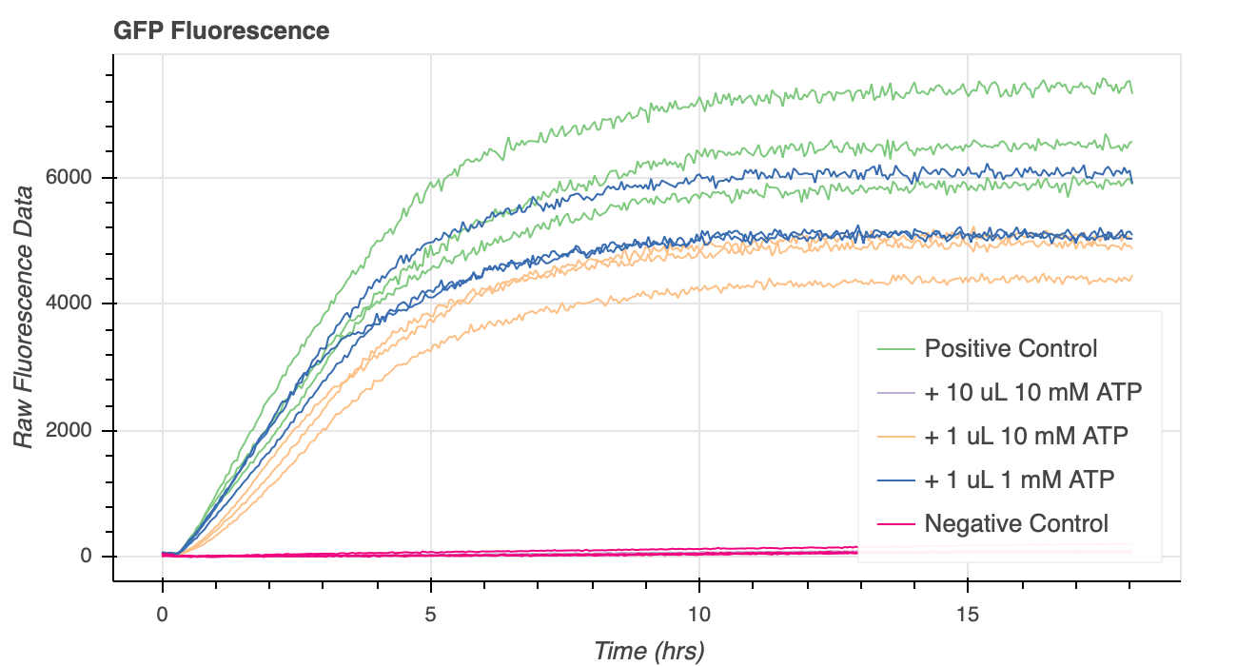
This is bad data because volume was not consistent

Slide 38
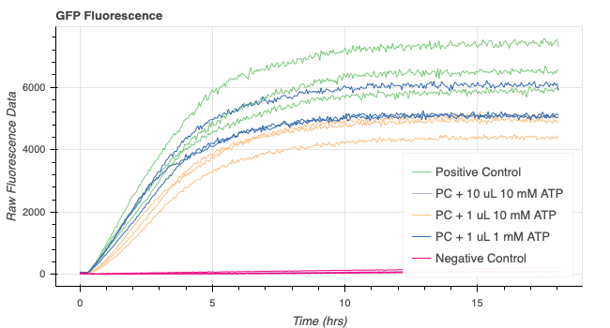
1.4.2020 With Processing Functions
Notes:
Adding more atp doesn’t seem to increase steady state values
Check slopes

Slide 39
Takeaways
Adding more atp doesn’t seem to increase steady state values
Check slopes

Slide 40
Exp 12: Reagents in Beginning
20201104_exp12_gfp_moreinbeg_timeseries

Slide 41
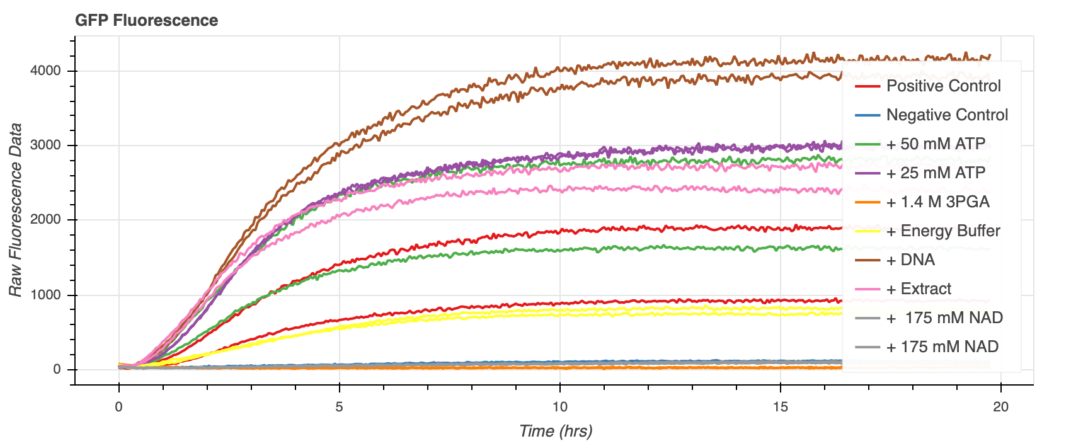
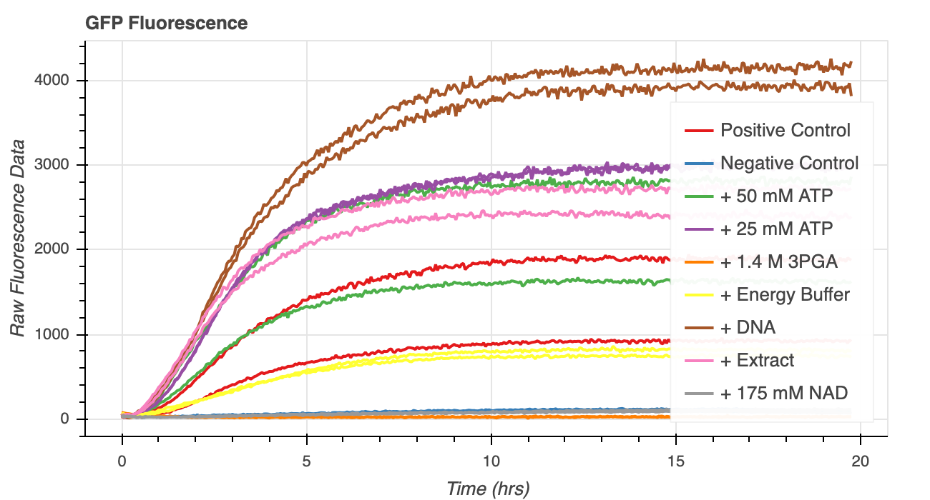
Seems weird since positive control doesn’t go to 4000, which I think it normally does

Slide 42
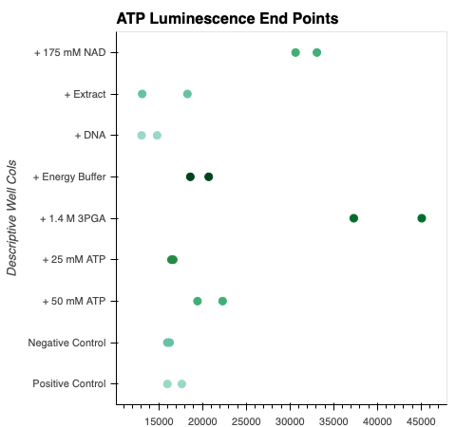
Data in raw lum values but doesn’t matter because not that accurate

Slide 43
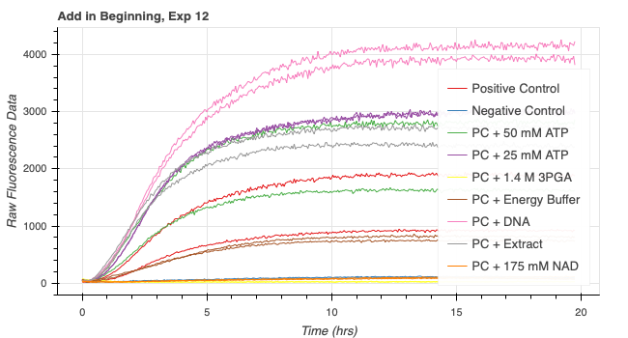
1.4.2021 with Processing Functions

Slide 44
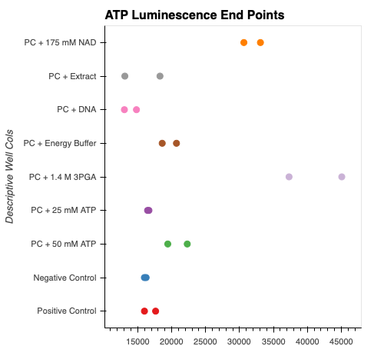
ATP Assay Endpt Vals with Processing funcs

Slide 45
TAKEAWAYS NEEDED

Slide 46
Exp 13: Spike Experiments
20201106_exp13_gfp_spike
20201107_exp13_gfp_post_spike

Slide 47
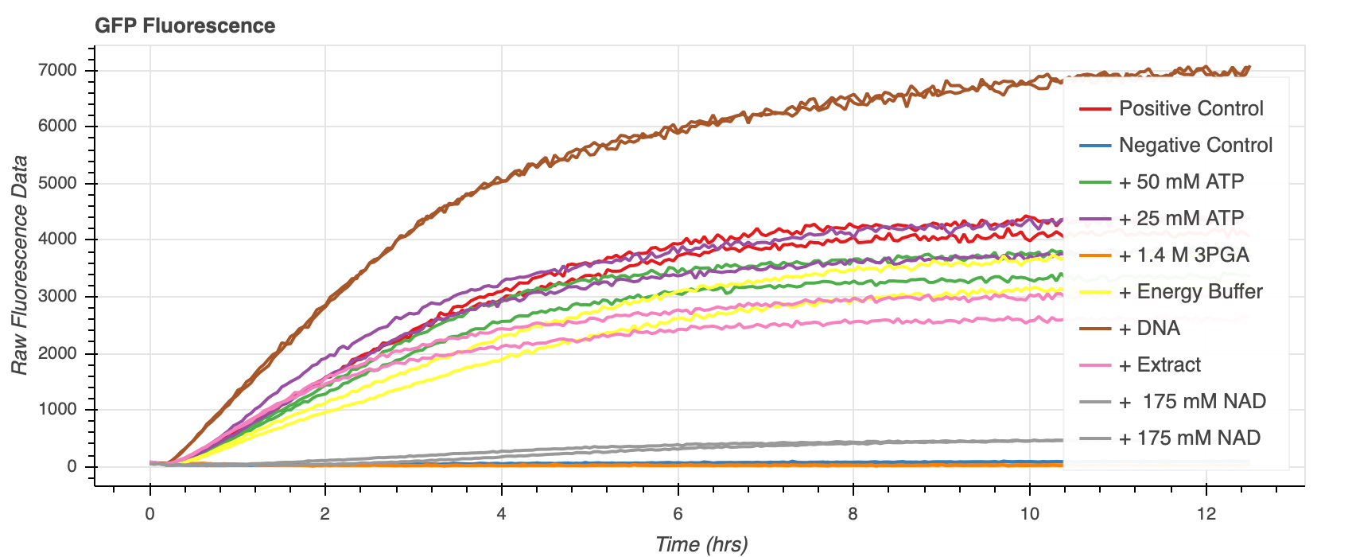
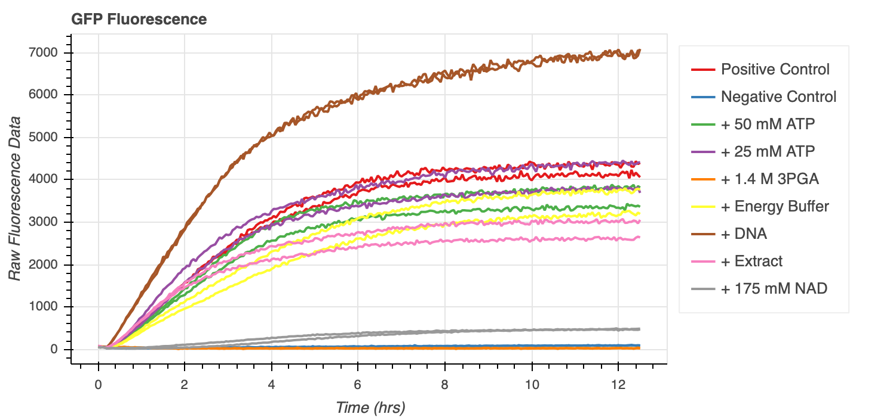
Pre Spike

Slide 48
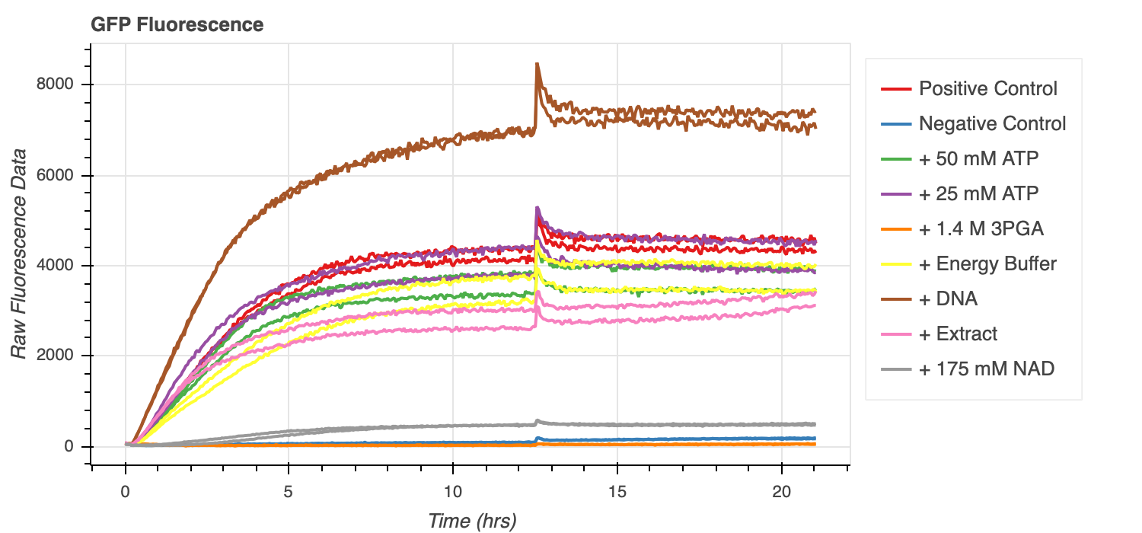
Post Spike

Slide 49
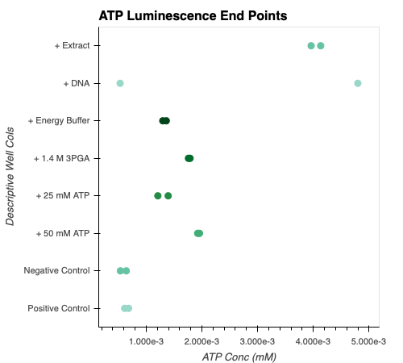
ATP End Point Values

Slide 50
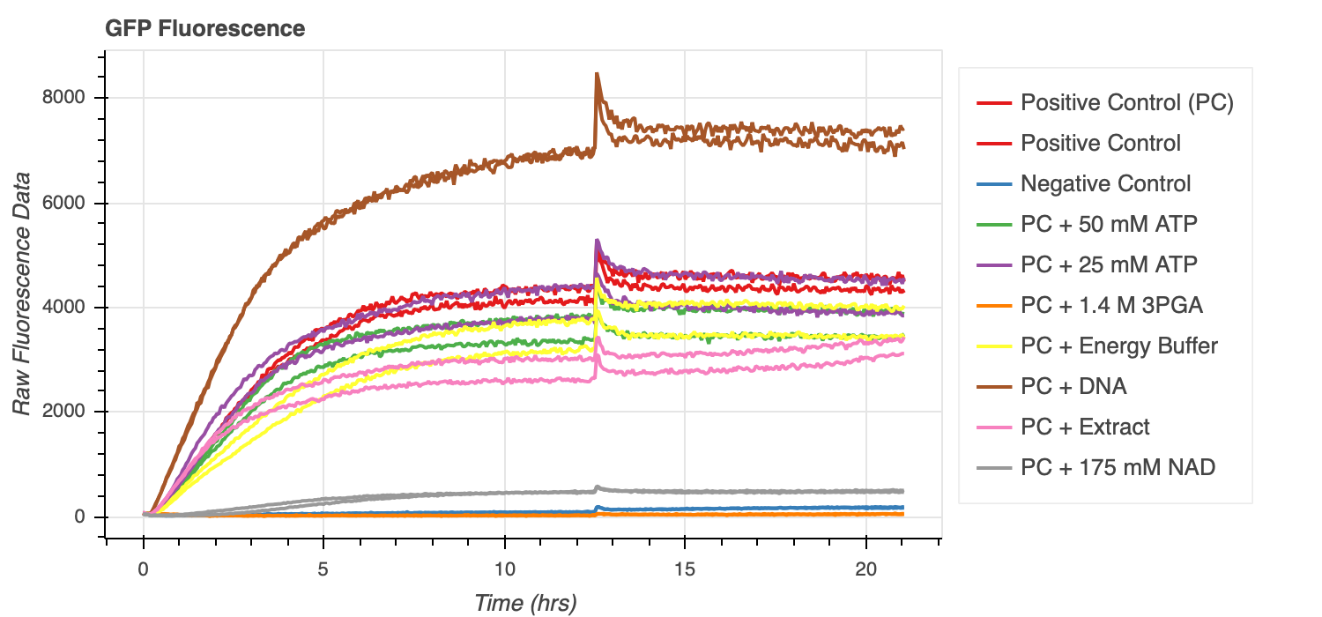
With Better Labels

Slide 51
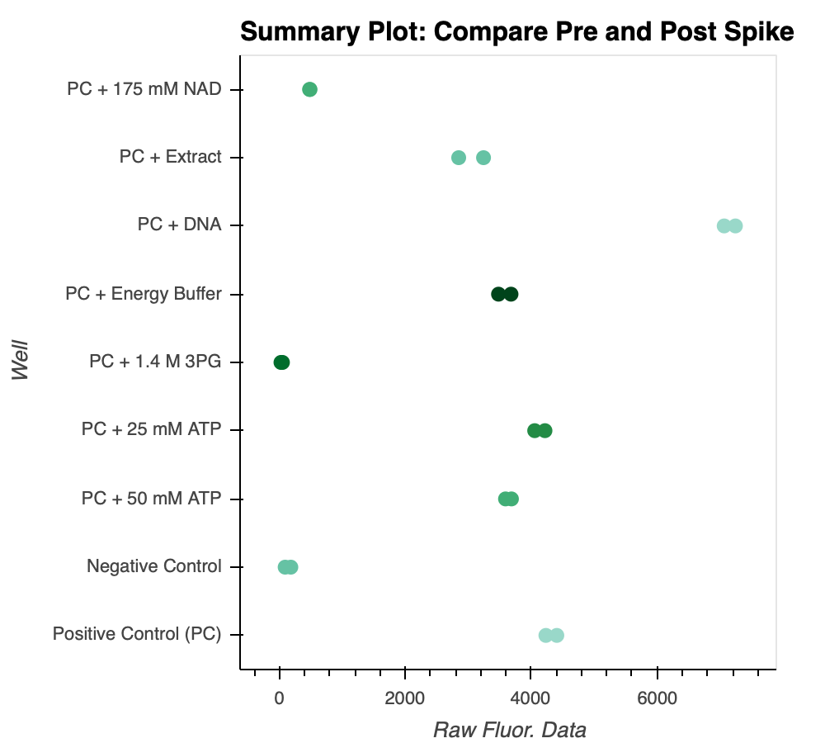
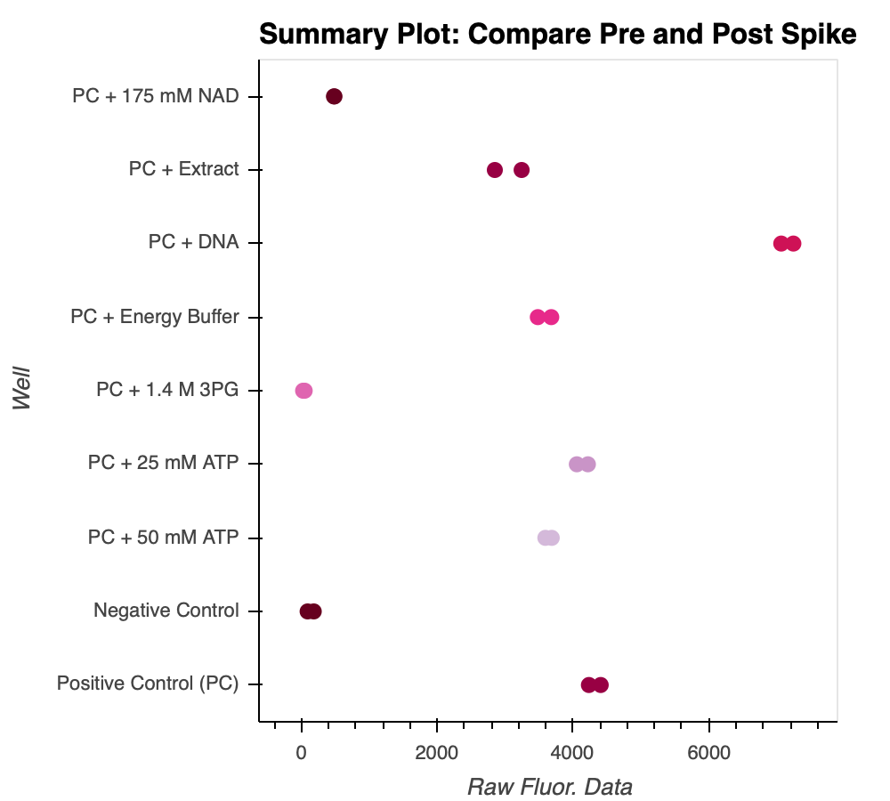
Summary Plot, compare pre and post spike

Slide 52
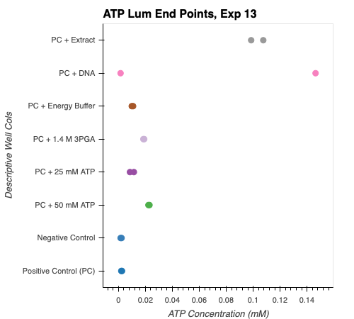
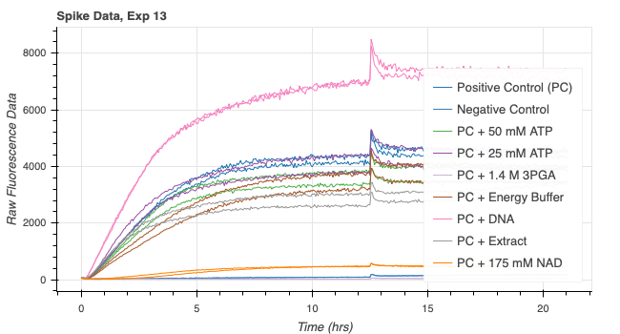
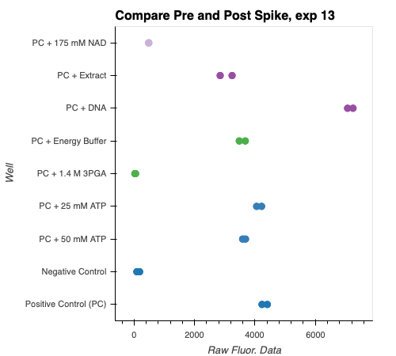
Plots with processing funcs 1.5.2021

Slide 53
Takeaways Needed

Slide 54
Exp 14\ Exp 14: ReDo Spike and More in Beg Experiments
20201115_exp14_gfp_atp_adp_moreinbeg_spike
Tried to use echo but wasn’t working,

Slide 55
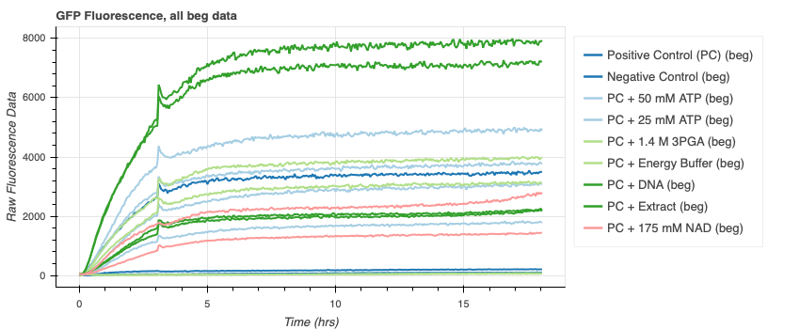
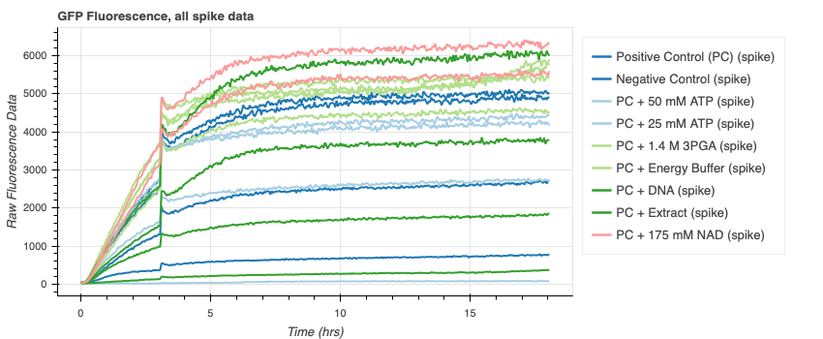

Slide 56
Need to add adp endpoint data here

Slide 57
Exp 15: ADP Assay Calibration
20201117_exp15_adp_assay_calibration

Slide 58
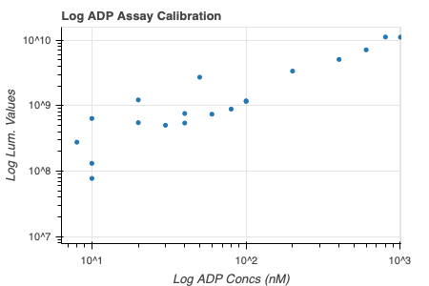
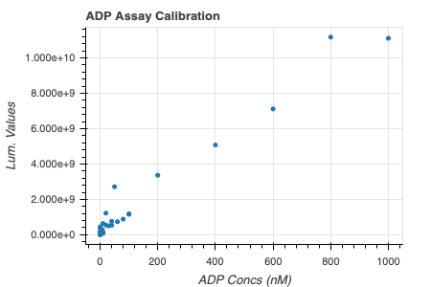

Slide 59
Exp 16: ADP and ATP Test
20201119_exp16_adp/atp_test
Try to see what happens when you add diff ratios of adp and atp

Slide 60
Make and add plots here

Slide 61
Exp 17: ADP Assay Calibration with Echo
20201119_exp17_adpassay_calibration_wecho
Didn’t look that great

Slide 62
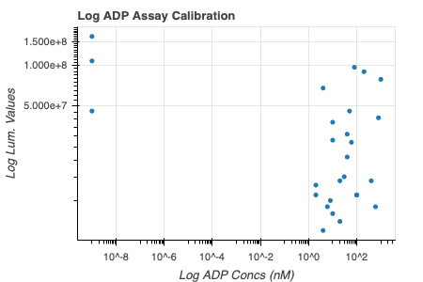
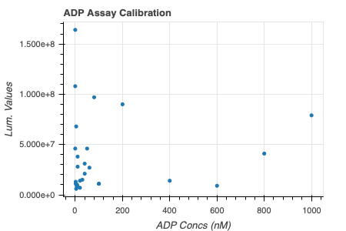

Slide 63
Exp 18: More in Beg and Spike Exp. With Echo
20201121_exp18_echospike
Finally some good data

Slide 64
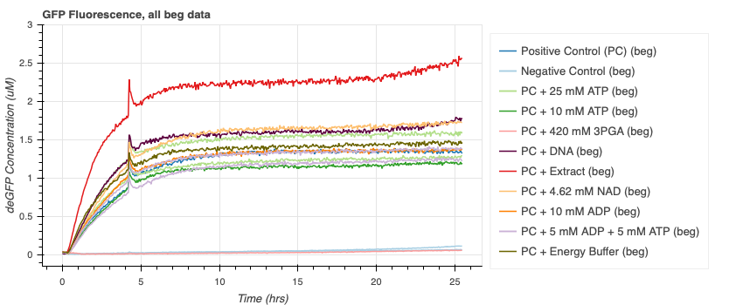
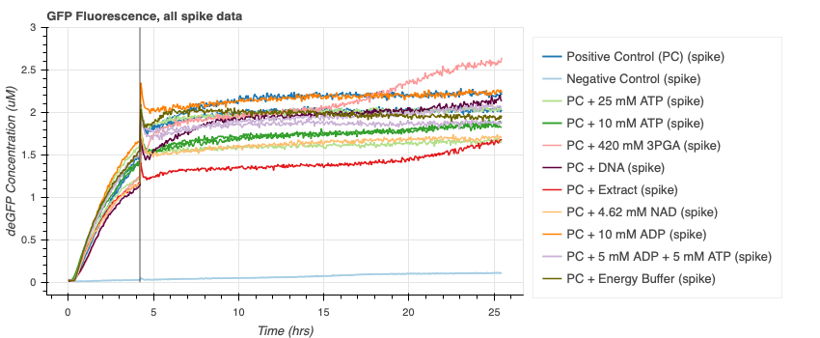

Slide 65




These added for lab mtg pres, only atp related wells

Slide 66
Exp 19: add ATP and take Pi endpoint data
20201203_exp19_adpatp_pi_test

Slide 67



This one without weird pc one and reversed so colors are better

Slide 68
Exp 20: Vesicles with GFP
20201204_exp20_vesicles_gfp
Tried to image vesicles with GFP, Buffer, Extract inside. Got some images but no GFP. Tried reading in biotek but no solid readout.

Slide 69
Img 4 might have some gfp if that’s the right channel

Slide 70
Exp 21: Vesicles with ACMA
20201205_exp21_vesicles_acma

Slide 72
Exp 26: GFP Time Series Controls
Repeating exp 7

Slide 73
Controls:
2x Positive control – deGFP DNA, buffer, extract
Negative control – extract
ATP depletion – buffer, extract
No buffer – deGFP DNA, extract
No extract – deGFP DNA, buffer

